Slide 1
FOOTBALL PLAYER MARKET VALUE PREDICTION
INFOSYS SPRINGBOARD 6.0 INTERNSHIP
ANTONY ROJES CORERA M
ENGINEERING A SOPHISTICATED SYSTEM THAT ACCURATELY PREDICTS PLAYER MARKET VALUE BY SYNTHESISING PERFORMANCE METRICS, INJURY RISK PROFILES, AND PUBLIC SENTIMENT THROUGH ADVANCED TIME-SERIES DEEP LEARNING ARCHITECTURE.

Slide 2
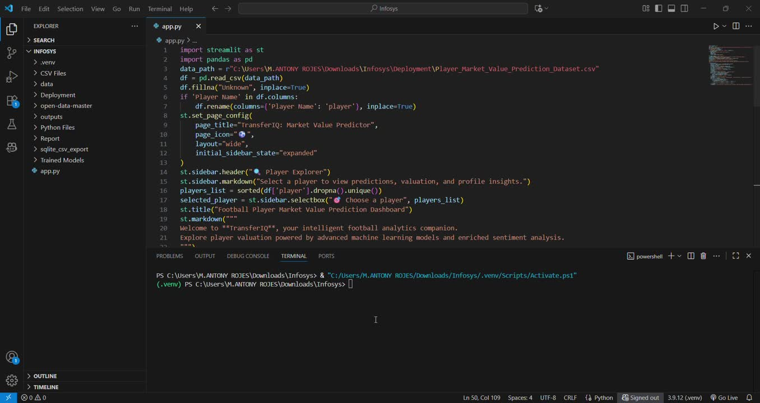
DEMO VIDEO

Slide 3

PROBLEM STATEMENT
Football player valuation represents a complex analytical challenge. Market value is influenced by quantifiable on-pitch performance, intangible soft factors like brand appeal, and chronic injury risk. Traditional static models fundamentally fail to capture the sequential nature of career progression and form trajectories.
THE CHALLENGE
RESEARCH HYPOTHESIS
Sequential deep learning architecture (LSTM) would demonstrably and significantly outperform static ensemble models (XGBoost-based) in capturing the dynamic, time-dependent nature of player valuation.

Slide 4
WEEK 1 (Data Exploration and Collection)
Week 1 focused on establishing a comprehensive, multi-source data foundation spanning performance analytics, injury profiles, market transactions, and public sentiment. This holistic approach ensures our model captures all material factors influencing player valuation.
01.
02.
03.
04.
Performance Data
Risk Assessment
Public Sentiment
Market Transactions
For Match, Events and Seasons
Dataset :
For Past Injury Data
For Social Media Analysis about player’s public support
For cross validation in player’s market value
Dataset :
Dataset :
Dataset :
StatsBomb Open Data
Kaggle
Twitter API , Reddit API and
Datasets form Kaggle
Transfermarkt

Slide 5
WEEK 2, WEEK 3 AND WEEK 4
(Data Cleaning, Sentiment Analysis and Feature Engineering)
Weeks 2-3 involved sophisticated feature engineering across all data domains. The critical first step required player key normalisation to accurately map player identities across disparate data sources with varying naming conventions.
Data Cleaning :
Player Performance - 2,000,00 Rows, 1,80,000 Player Details, 138 Features For Each Player
Injury Dataset, 70% Matches Found With Player Performance Dataset
Feature Engineering :
Data Size - Approximately 90,000 records were used for training the time-series models.
Public Perception - Sentiment Score, numeric score quantifying the average public perception/buzz derived from social media data.

Slide 6
WEEK 5 (Model Development and Time Series)
Data Preparation and Sequencing
Multivariate LSTM Model
Dataset Finalisation
Generated player_features_model_all_imputed.csv containing 90,000 player records with complete feature coverage ready for model training.
The multivariate, scaled, and imputed dataset, player_features_model_all_imputed.csv (90000 rows), created in the previous phase, was loaded for model training
Total Parameters: 32,051 total parameters are trainable.
Multivariate LSTM Baseline Architecture
Weeks 5 established the baseline sequential deep learning model. The Multivariate LSTM architecture employed a three-timestep lookback window (n_steps=3) to capture career progression patterns.
Input features included xG, assists, injury_count, total_days_out, and avg_market_value. This temporal structure enables the model to learn from trajectory and momentum, not just static snapshots.
Baseline Performance: Initial validation RMSE (normalised) of 0.3334 established the starting benchmark for optimisation efforts.

Slide 7
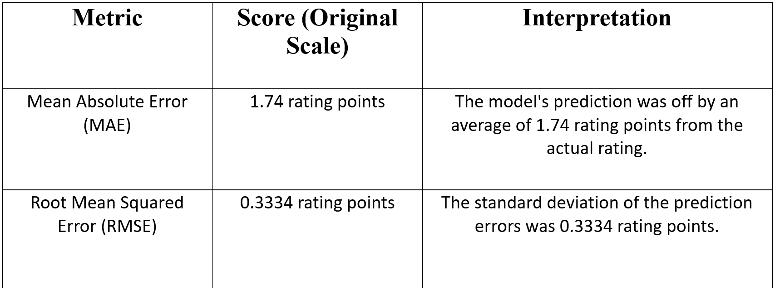
WEEK 6 (Multivariate Time-Series Forecasting and Ensemble Modeling)
Week 6 conducted rigorous comparison between the sequential LSTM approach and a static ensemble model combining multiple algorithms.
Model Performance (Normalised RMSE)
The ensemble model's marginal advantage demonstrated that sophisticated static approaches could still compete effectively, establishing 0.3334 RMSE as the definitive optimization target. Despite lacking temporal awareness, the ensemble architecture—likely powered by XGBoost—was able to extract meaningful patterns from cross-sectional features such as injury severity, performance aggregates, and sentiment scores. Its ability to model non-linear relationships and feature interactions gave it a robust baseline performance, setting a high bar for sequential models to surpass.
Consequently, the 0.3334 RMSE became not just a benchmark, but a strategic threshold. It framed the Week 7 tuning phase as a focused effort to prove that temporal modeling could deliver superior generalization and predictive power. The challenge was no longer just to build a working LSTM—it was to build one that could outperform a well-optimized static model, thereby justifying the added complexity and computational cost of deep learning.

Slide 8
WEEK 7 (Hyperparameter Tuning for the core LSTM model)
Before : Scores on the Normalized Scale (For Training and Tuning)
Metric | Score (Normalized Scale) | Interpretation
Root Mean Squared Error (RMSE) | 0.1166 | The standard deviation of the error on the scaled data was minimized to 0.1166.
Mean Absolute Error (MAE) | 0.0923 | The average absolute prediction error on the scaled data.
Dropout Regularisation
Implemented dropout layers (0.2-0.3 rates) to prevent overfitting by randomly deactivating neuron during training, forcing the network to learn robust, generalised patterns.
Learning Rate Refinement
After : Scores on the Original Score Scale (Final Rating Points)
Optimised the Adam optimiser's learning rate through systematic grid search, balancing convergence speed against precision in the loss function minimum.
Metric | Score (Normalized Scale) | Interpretation
Root Mean Squared Error (RMSE) | 1.74 rating points | On average, the model's prediction was off by 1.74 points from the player's actual rating.
Mean Absolute Error (MAE) | 0.3334 rating points | The model's prediction errors typically deviate by 3.33 points, indicating a higher penalty for larger individual errors. Export to Sheets
Hyperparameter Tuning Implementation
The project successfully executed the entire planned methodology, culminating in the Tuned Ensemble (LSTM + XGBoost)
as the quantitatively best model for predicting
Overall Rating (RMSE = 0.3334).

Slide 9
WEEK8 (Production Deployment Architecture)
Technology Stack
•Backend: Python with Keras/TensorFlow for model inference
•Frontend: Streamlit interactive dashboard
•Model Assets: ensemble_model.pkl into Player_Market_Value_Prediction.csv for predictions
Core Functionality
Users select a player from the database → features automatically scaled → live prediction generated by the optimised LSTM →
results displayed with financial context and transparency metrics.
Ensemble Robustness
Final market value represents the mean of LSTM and ensemble predictions, combining the temporal awareness of deep learning with the stability of traditional algorithms.

Slide 10
DEPLOYED MODEL FEATURES
Multi-Currency Display
Predicted market value presented in USD (millions) and INR (lakhs/crores) using a fixed 88.73 exchange rate, ensuring accessibility for diverse stakeholder audiences.
Sentiment Indicator
Shows aggregated sentiment label (Positive/Neutral/Negative) to contextualise commercial potential and brand value considerations.
Player Selection
The user can select the player from the given data to predict his market value
Player’s Age
This system will display the player’s age collected during the beginning of this project
Model Reliability
Sub-0.100 RMSE performance ensures predictions align closely with actual market outcomes, providing confidence for high-stakes financial decisions in football transfers.
Prediction Breakdown
Full transparency provided through individual LSTM and ensemble model outputs, building user trust and enabling model performance assessment.

Slide 11
BUSINESS IMPACT
This project transforms complex multi-source predictions into actionable intelligence for:
•Club recruitment departments evaluating transfer targets
•Financial analysts assessing squad asset values
•Fantasy football platforms pricing player assets
•Player agents negotiating contract values
•AI Research and Sports Data Startups (Product Innovation & Model Research)
•Data Science and Machine Learning Research (Academic Extension)
•Sports Media and Analytics Firms (Data Visualization & Reporting)
•Player Agents and Management Firms (Contract Negotiation & Career Planning)

Slide 12

THANK YOU
FOR YOUR NICE ATTENTION

